Slide 1
Crafting Your Professional Digital Portfolio
Bethany Van Scooter || 2 April 2020

Slide 2
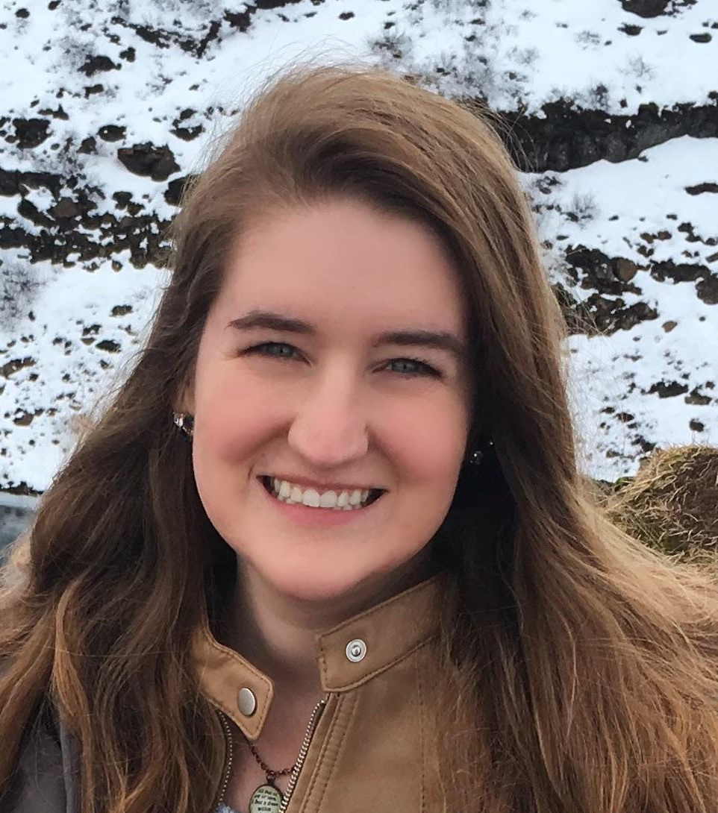
HELLO!
About the Presenter
Who am I and why am I teaching this?
2nd year MA graduate student
My background
MA -- Writing Studies
BA -- Professional Writing
BFA -- Creative Writing
I have created portfolio sites for both industry (marketing & nonprofit) and academic jobs, as I have pursued both.
I love cats, working from home is difficult but I like being home in general, and I’m 50% coffee

Slide 3
Who are you?
Name?
Type of portfolio (Academic, industry, non-profit, gov’t, etc.)?
Favorite at-home, non-work-related activity right now?

Slide 4
01
Why Have a Digital Portfolio?

Slide 5
ACADEMIA
NON-ACADEMIA
Showcase written statements (teaching, research, diversity)
Illustrates teaching and research efficacy
Gives a personal touch that CVs might not offer
Showcase projects (such as design, labs, papers, communications, etc.
Conveys your “personal brand” succinctly
Argues for your work efficacy better than a static resume might

Slide 6
Digital Age!
Having an online portfolio makes it easier to
display your abilities in a concise way,
search and find on the internet,
build credibility in a personal way before meeting an employer, and
control your personal “brand” and what others see and learn about you

Slide 7
02
Elements of Design
Visual design crash course

Slide 8
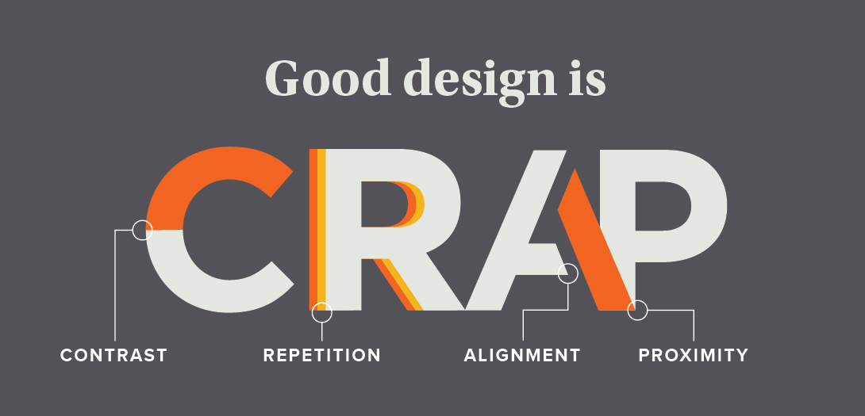
Unfortunately known as “CRAP” Principles

Slide 9
“PARC” Your Designs
Proximity
Alignment
Repetition
Contrast
Proximity means that things are associated with one another – or not. The closer things are, the more they are associated.
Repetition, for instance making a header and footer the same color, makes scanning a website easier. Another example: bullet lists!
Creating contrast for elements means that discrete elements stand out.
Columns within a page makes it easier to scan horizontally.

Slide 10
Let’s Play!
“Good Design or Bad Design?”

Slide 11
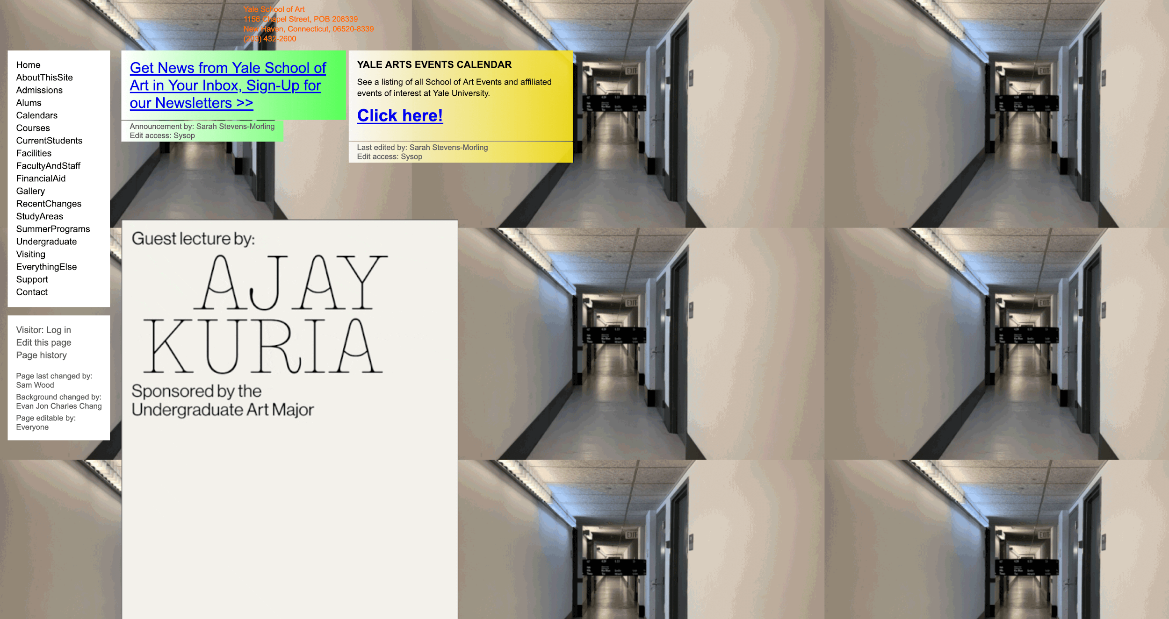

Slide 12
“Good Design or Bad Design?”

Slide 13
BAD DESIGN! But… why?

Slide 15
Let’s do another one!

Slide 16
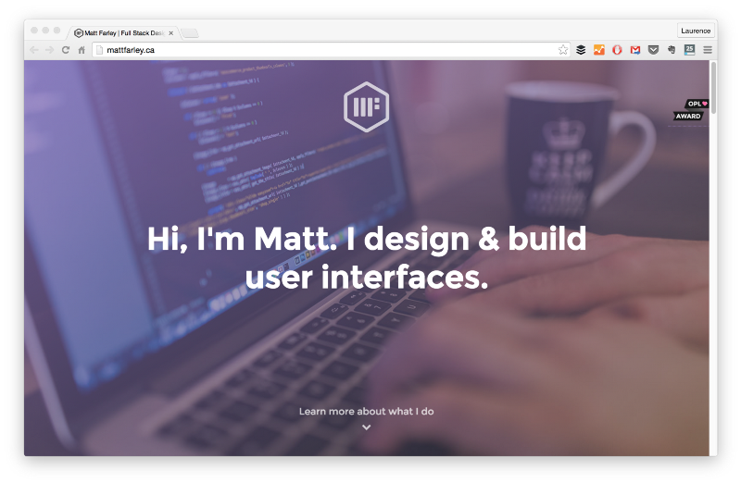

Slide 17
“Good Design or Bad Design?”

Slide 18
GOOD DESIGN! So… why/how?

Slide 20
OTHER CONSIDERATIONS
Consistency
Web Effects
Pairing Fonts
Similar to repetition, make sure your documents across mediums are consistently designs (e.g. same fonts, colors, language, etc.)
Don’t get crazy. If you use an effect, only use it once and use it for a specific impact. Otherwise, keep the design clean and clear.
Make sure that you are pairing no more than three fonts across all documents/pages in your site and that these fonts are complementary… (see next slide)

Slide 21
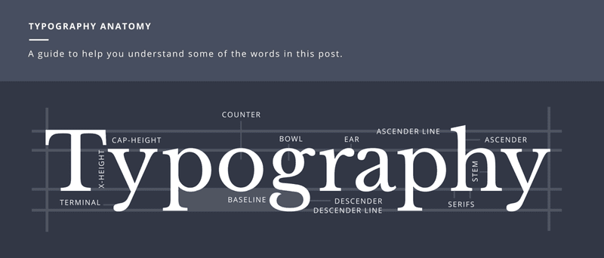
From Canva’s Font Guide (click here)

Slide 22
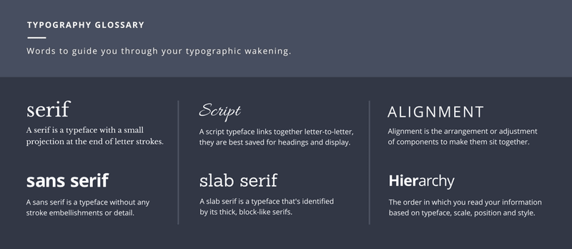
From Canva’s Font Guide (click here)

Slide 23
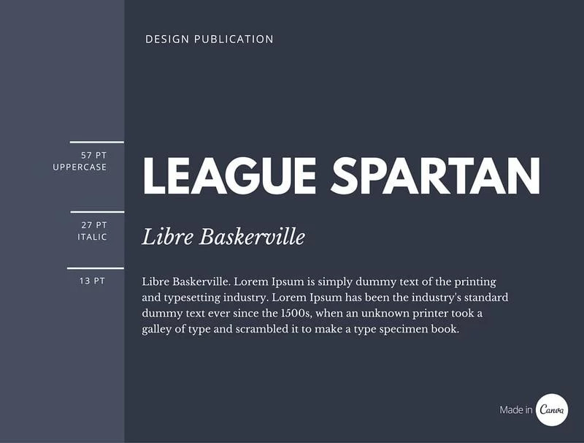
Example 1: Sans Serif + Serif

Slide 24
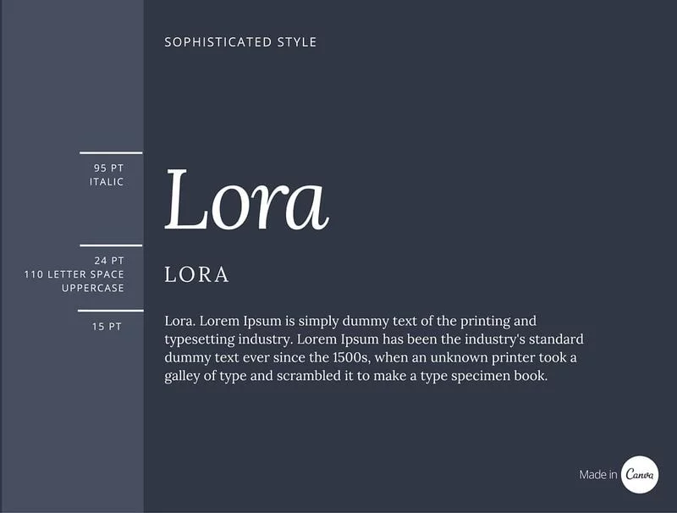
Example 2: Consistent w/ Italics

Slide 25
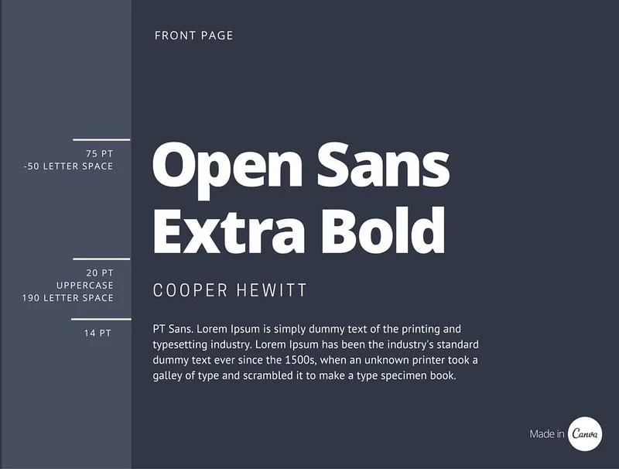
Example 3: Experimenting w/ scale

Slide 26
03
ORGANIZING YOUR WEBSITE
What should/could you include to best represent yourself?

Slide 27

Pictures!
Always include clear, crisp images of you for specific purposes.

Slide 28
OTHER INFO TO INCLUDE
DOCUMENTS
PROJECTS
VIDEOS
BACKGROUND
For academia, this could include various statements of teaching, research, etc. Also consider scanned certificates and awards
Visual examples of your completed projects, not just verbal mentions. Search your coursework, internships, etc. for the best examples of your abilities.
Videos of you teaching, in the lab, volunteering, at your internship/job, etc.
Personality! Do you have hobbies you’re willing to share? Other interests outside of school/work?

Slide 29
For Academic Job Seekers...

Slide 30
PAGES IN YOUR PORTFOLIO TO HAVE
Statements with Purpose
Teaching Effectiveness
Education & Training Evidence
At the very least, make sure your teaching statement/philosophy is easy to find. Others include diversity statements and research statements.
This shows employers that you have taught before and did well!
If you have not taught, make sure to feature others’ recommendations on this page, then
Have a page dedicated to all the educational and professional training you’ve done. E.g. the TCC certificate training, this and other library workshops, etc.

Slide 31
ACADEMICS: INCLUDE LESSON PLANS
 | WEEK 1 | WEEK 2 | WEEK 3
LESSON | Thesis Writing | Research & Citations | Peer Review & Revision
EXERCISE | Write and rewrite the thesis to a well-known argument | APA citation jeopardy | Checklist overview to make sure your paper is doing what it needs to be doing
PRACTICE | Write your own thesis and have your partner rewrite. | Cite one of your sources and have your table check it. | Peer review with a partner using the “compliment sandwich”

Slide 32
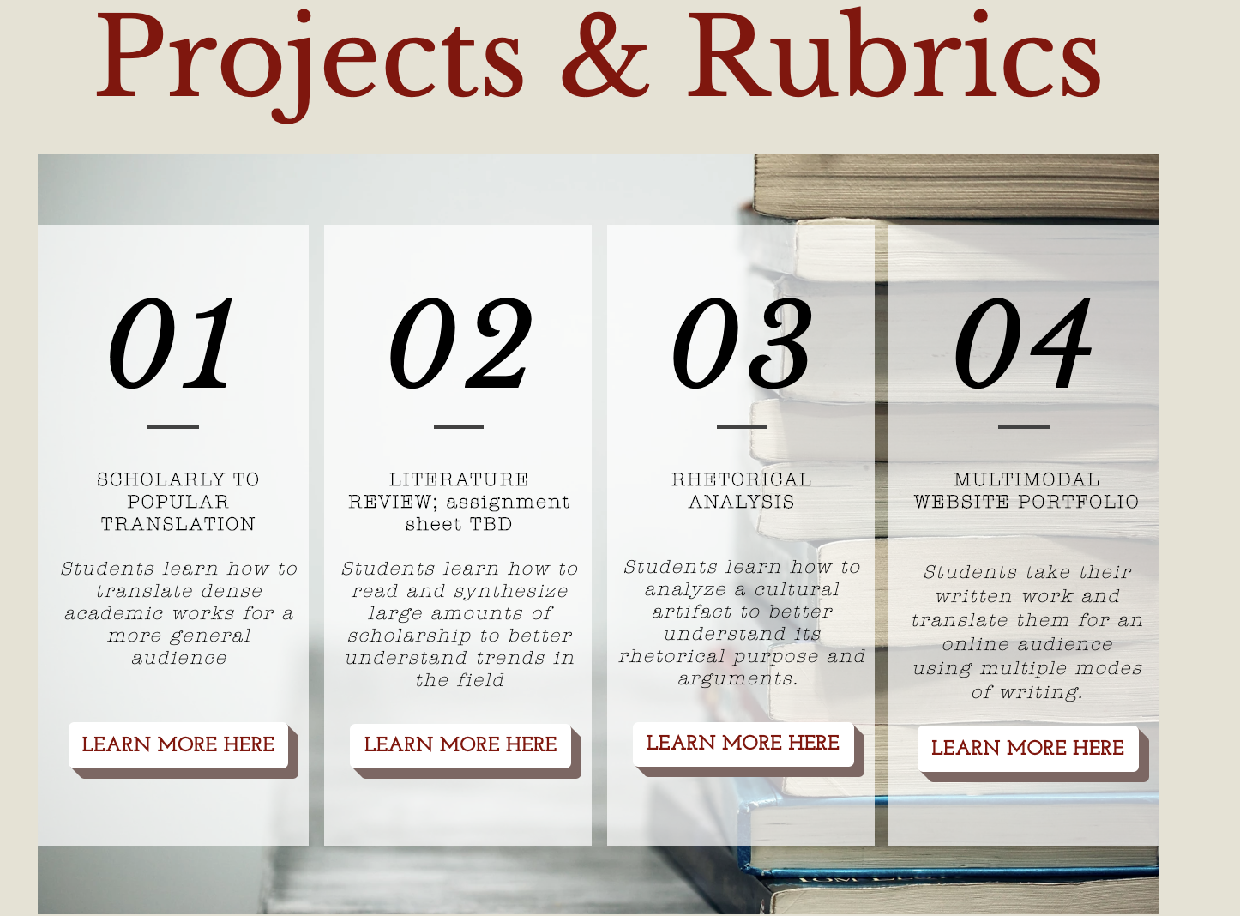
INCLUDE RUBRICS & ASSIGNMENTS

Slide 33
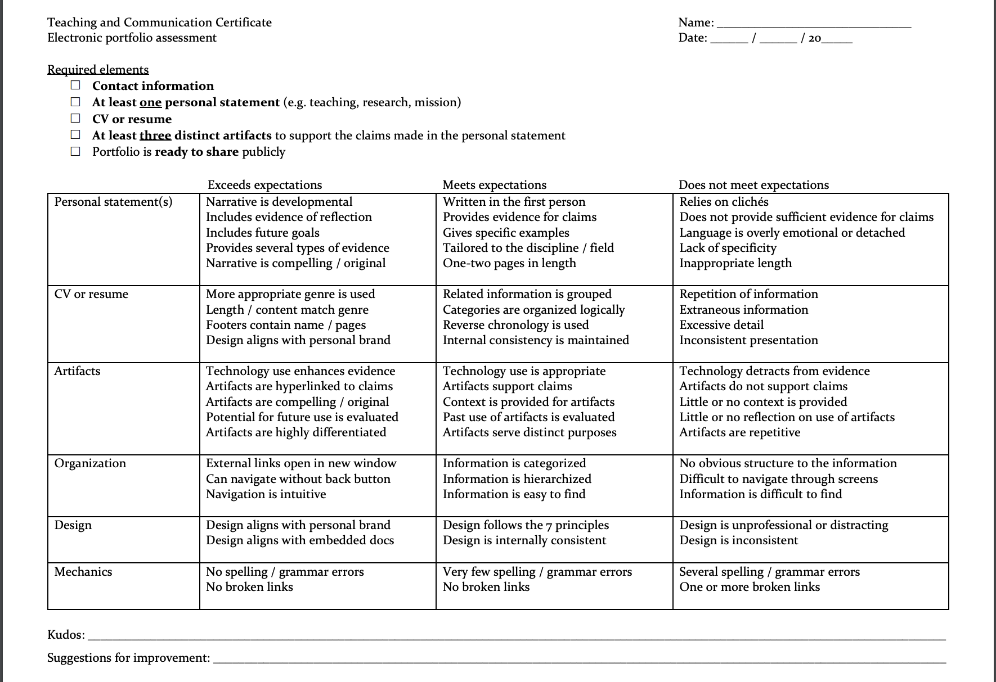
TCC REQUIRMENTS OVERVIEW

Slide 34
For Industry/ Gov’t/NonProfit Job Seekers

Slide 35
HAVE A FOCUS
WORKSHOP LESSONS
SHOWCASE PROJECTS
REFERENCES
CONTACT INFO
RESUME
What is the goal of your site? What kind of worker are you?
Seriously. This gives employers tangible evidence of your work ability.
Recommendations, quotes, and testimonials about your work are excellent!
Make sure employers have a clear way to contact you from the get-go!
Either translate your resume into its own page or link to a PDF reader for easiest accessibility.

Slide 36

Resources for free content to add to your website
Noun Project (free icons): http://thenounproject.com/
Free stock photos:
Unsplash: unsplash.com
Pixabay: pixabay.com
Pexels: pexels.com
Website Builders:
Wix (w/o ads = $$)
Google Sites
Wordpress
Github
Squarespace ($$)
SiteBuilder ($$)
Weebly ($$)
Adobe Site Builder ($$)

Slide 37
Example Websites
BETHANY VAN SCOOTER (English Teacher)
https://beshower.wixsite.com/portfolio
DIANNA M. FRANCISCO (Atmospheric Science Postdoc)
https://www.diannafrancisco.com/
JAMES RUSSELL (Atmospheric Science Postdoc)
https://jrussell.chpc.utah.edu/
https://sites.google.com/view/james-russell/home
TRAVIS MERCHANT (Film Maker)
https://travismerchant.squarespace.com/
RUBEN MUSCA (Photographer/Videographer)
https://rubentellsstories.myportfolio.com/
ISABELLE HAHN (Marketer/Journalist)
https://www.isabellehahn.com/

Slide 38
04
CRAFT YOUR SITE!
Let’s start crafting our websites. If you already have one, let’s tweak it.

Slide 39
Thank You!
Please fill out this survey:
GO.NCSU.EDU/PSEVAL
More Resources:
More portfolio ideas
Understanding “UX” (User Experience)

